Slide 1
Pointers and Dynamic Data Structures

Slide 2
Pointers
A pointer is a variable that contains the address in memory of another variable where the data is actually stored.
Primarily used where:
Data objects must be created and destroyed dynamically and,
The number of data objects is unknown
Declared using the POINTER attribute or by listing it in a separate POINTER statement.
Pointer
Variable
Address of variable
Data Value
REAL, POINTER :: p1
or
REAL :: p1
POINTER :: p1

Slide 3
Pointers to Arrays and Derived Data Types
Pointer to derived data types may also be declared:
Pointers may also point to an array.
Declared with a deferred-shape array specification
TYPE(vector), POINTER :: p1
INTEGER, DIMENSION(:), POINTER :: p1
INTEGER, DIMENSION(:,:), POINTER :: p2

Slide 4
Pointer Targets
A pointer can point to any data object of the same type provided:
It has been declared to be a target.
Target - a data object whose address has been made available for use with pointers.
Declared using by either including the TARGET attribute or by listing it in TARGET statement.
REAL, TARGET :: a1 = 7.0
INTEGER, DIMENSION(10), TARGET :: int_array
or
REAL :: a1 = 7.0
INTEGER, DIMENSION(10) :: int_array
TARGET :: a1, int_array

Slide 5
Pointer Assignment Statements
A pointer can be associated with a given target by means of a pointer assignment statement.
When executed the memory address of the target is stored in the pointer.
After this, any reference to the pointer will actually be a reference to the data stored in the target.
The value of one pointer can also be assigned to another.
After assignment, both pointers point directly and independently to the same target.
pointer => target

Slide 6
Pointer Association Status
Association status indicates whether or not the pointer currently points to a valid target.
Three possible statuses:
Undefined – When first declared and before its used
Associated – The pointer is assigned a valid target
Disassociated – The pointer no longer points to a target and has not been assigned a new target.

Slide 7
Setting and Determining Status
A pointer can be disassociated with its targets by executing a NULLIFY statement.
Fortran provides the intrinsic function ASSOCIATED.
Used to determine the association status of a pointer.
The function has two forms:
Returns TRUE if the pointer is associated with any target
Returns TRUE if the pointer is associated with the particular target included in the function.
NULLIFY (p1 [,p2, …])
status = ASSOCIATED(pointer)
status = ASSOCIATED(pointer, target)

Slide 8
The NULL Function
Every pointer’s status should be clarified as soon as it is created:
By assigning it to a target or
By nullifying it.
The Fortran intrinsic function, NULL(), can be used to nullify a pointer at the time it is declared.
REAL, POINTER :: p1 = NULL( ), p2 = NULL( )
INTEGER, POINTER :: I1 = NULL( )
…

Slide 9
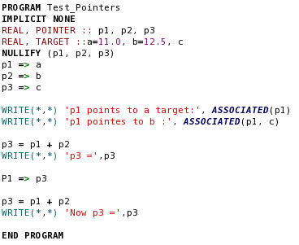

NULLIFY and ASSOCIATED Function Example:

Slide 10
Using Pointers in Assignment Statements
Whenever a pointer in a Fortran expression is use where a value is expected, the value of the target pointed to is used instead of the pointer itself. This process is know as dereferencing the pointer.
p2 = p1 same as b = a
p2 => p1 same as p2 => a

Slide 11
Using Pointers with Arrays
A pointer to an array must declare:
The type and the rank of the array,
Does not declare the extent
A pointer can point to:
An array or
An array subset
A pointer will work with array sections
Defined by subscript triplets
But not those defined by vector subscripts

Slide 12
Dynamic Memory Allocation with Pointers
Pointer allocation can be used to dynamically create variables or arrays whenever required
Pointer deallocation is used release the space when no longer needed.
The procedure is similar to that used to create allocatable arrays.
Memory is allocated using the ALLOCATE statement
Memory is deallocated using the DEALLOCATE statement.
The allocation statement takes the form:
A failed allocation statement without the STAT= clause will cause the program to abort.
ALLOCATE (pointer(size) [, ...], STAT=status)

Slide 13
ALLOCATING Pointers
The ALLOCATE statement creates:
An unnamed data object of the specified size and the pointer’s type
Sets the pointer to point to the object.
The data can only be accessed by using the pointer.
If the pointer is either nullified or re-associated with other targets:
The data object will no longer be accessible.
The data is still in memory but it can no longer be accessed.
This unusable memory is commonly referred to as a memory leak.

Slide 14
DEALLOCATING Pointers
Allocated memory should be deallocated it is no longer needed.
Memory is deallocated using the DEALLOCATE statement.
The specified pointer is nullified at the same time.
Can only deallocated memory that was created by an ALLOCATE statement
Only the specified pointer will be automatically nullified by the DEALLOCATE statement
Any others should be nullified in a NULLIFY statement.
It is possible to mix pointers and allocatable arrays in a single ALLOCATE or DEALLOCATE
DEALLOCATE (pointer[, ...], STAT=status)

Slide 15
Using Pointers as Components of Derived Data Types
Pointers may appear as components of derived data types.
Pointer in derived data types may point to the derived data type being defined.
Allows construction of dynamic data structures that are linked together by successive pointers.
Linked List
Simplest dynamics data structure
Defined as a list of values linked together in a linear fashion by pointers
For example:
TYPE :: real_value
REAL :: value
TYPE(real_value), POINTER :: p
END TYPE

Slide 16
Linked List Example:
Value
Value
Value
NULL
Pointer
Pointer
Pointer
Head
Tail
Permit addition of one element at a time
Do not have to know how many elements will ultimately be in the list

Slide 17
Building a Link List
NULL
NULL
Head
Tail
Value
Value
At the start
NULL
Pointer
Pointer
Value
Head
Tail
NULL
Second Element added
Pointer
Once all the variables are read in the program can process them by starting with the head pointer and following the pointers in the list until the tail is reached.
Head
Tail
First Element added

Slide 18
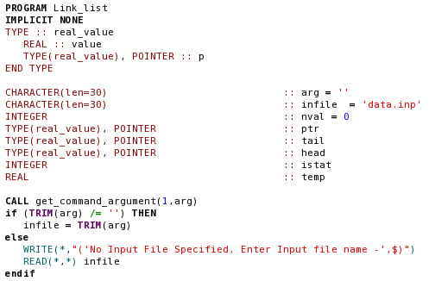
Example: Creating a Linked List

Slide 19
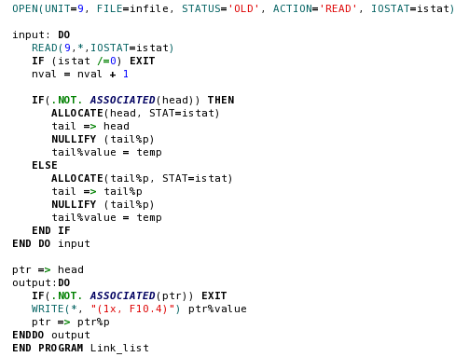
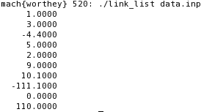

Slide 20
Arrays of Pointers
A Pointer may not be declared to be an array.
The DIMENSION attribute in a pointer declaration refers to the dimension of the target
However, an array of pointers can be created using derived data types.
Define a derived data type containing only a pointer.
Create an array of that data type.

Slide 21
Using Pointers in Procedures
Pointers may be used as dummy arguments in procedures
May be passed as actual arguments to procedures.
A function results can be a pointer.
Restrictions
Procedure interface must be explicit
If a dummy argument is a pointer, then
Actual argument must be a pointer of the same type, kind, and rank.
In FORTRAN 95, a pointer dummy argument cannot have an INTENT attribute.
In FORTRAN 2003 a pointer dummy argument can have an INTENT attribute
The INTENT refers to the pointer, not the target.
A pointer dummy argument cannot appear in an ELEMENTAL procedure
As program grow more complex it is very important that:
The status results be checked for all ALLOCATED and DEALLOCATED statements
Pointer status be checked using the ASSOCIATED function.

Slide 22
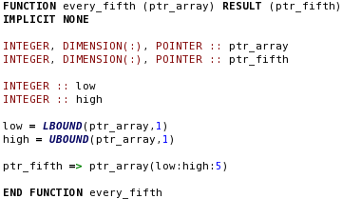
Pointer-Valued Functions
A Pointer-Valued Function is a function that returns a pointer value.
The function RESULT clause must be used in the function definition
The RESULT variable must be declared to be a pointer.

Slide 23
More Pointer-Valued Function
A pointer-valued function must have an explicit interface in any procedure that uses it.
Once defined, the function can be used any place that a pointer expression can be used:
The function can also be used in a location where an integer array is expected:
In this case, the returned pointer will automatically be dereferenced and the values pointed to will be used.
p => every_fifth(ptr_1)
WRITE(*,*) every_fifth(ptr_1)

Slide 24
Procedure Pointers
In FORTRAN 2003 pointers can refer to a procedure instead of a data object.
A procedure pointer is declared by the statement:
Has the same calling sequence as procedure sub1
Once declared the pointer will work with any subroutine with the same interface as sub1.
Must have an explicit interface.
PROCEDURE (sub1), POINTER :: p => NULL()
p => sub1
so
CALL p(a, b, c)
identical to
CALL sub1(a, b, c)
p => sub2
so
CALL p(a, b, c)

Slide 25
Binary Tree Structures
Dynamic data structure
Consisting of repeated components (or nodes)
Arranged in an inverted tree structure.
Each component is a derived data type that
Stores some sort of data
Two pointers to other variables of the same type
An important requirement is that components must be sortable according to some know criteria.
TYPE :: person
CHARACTER(len=10) :: last
CHARACTER(len=10) :: first
CHARACTER :: mi
TYPE(person), POINTER :: before
TYPE(person), POINTER :: after
END TYPE
Last
First
MI
before
after

Slide 26
Jackson, Andrew D
Johnson, James R
Johnson, Jessie R
Johnson , Andrew C
Chapman, Stephen J
Gomez, Jose A
Chapman, Rosa P
Jackson
Andrew
D
before
after
Chapman
Stephen
J
Johnson
James
R
before
after
before
after
Chapman
Rosa
P
Gomez
Jose
A
Johnson
Andrew
C
Johnson
Jessie
R
before
after
before
after
before
after
before
after

Slide 27
The Significance of Binary Tree Structures
A binary tree can be used to sort data
It is also a very efficient way to:
Store,
Search, and
Retrieve data values
The worst sort of data to store in a binary tree is sorted data.
Most databases are structured as binary trees.
They often include hashing techniques to partially randomize the order of the data stored
Because each node looks and behaves just like any other node, binary trees are perfectly suited for recursive procedures.

Slide 28
Good Coding Practice
Always nullify or assign all pointers as soon as they are created.
In sorting and swapping large arrays, it is more efficient to exchange pointers than it is to manipulate the data itself
Always nullify or reassign all pointers to a memory location when that memory is deallocated.
Always test the association status of any pointers passed to procedures as calling arguments.

